Slide 1
Topic Modeling

Slide 2
Topic Modeling
You have five seconds to look at this text and figure out what it is about.
What is this text about?
How do you know?
Notes:
Look at this text. What is it about? How do you know?
What does this tell us about how you read?

Slide 3
Topic Modeling
You’re each given the scrambled text of three document.
What are they about? Pick 3 themes or topics for each text. Texts can share topics.
How do you know?
Notes:
Next activity – get in your group. a more advanced form of counting words. Not just about counting individual words. It’s about telling what they’re about. How can you tell?
Text 1 – Jack the Ripper, newspaper article
Text 2 – Sherlock Holmes, Scandal in Bohemia
Text 3 – http://www.npr.org/sections/health-shots/2016/09/13/493289511/doctors-test-drones-to-speed-up-delivery-of-lab-tests
What did you find?

Slide 4
Topic Modeling
Text 1: evidence, medicine, murder
Text 2: evidence, love, woman
Text 3: medicine, news, transportation
Notes:
You get anything else? How did you know what topics the texts had if you didn’t have the order of the words?
Not just about word count – it’s also about collocating words. Counting with an eye towards what words occur next to each other.

Slide 5
What Have We Learned?
You don’t need to read in sequence to know the theme.
You don’t need to read everything to know a theme.
But clusters of words can tell you an awful lot.

Slide 6
Definitions
Syntagmatic axis – the sequence of words, the order they come in. Take it a way, and you have a word jumble.
Bag of words – a text with the syntagmatic axis removed. Just the tokens and counts.

Slide 7
Bag of Words
Vocabulary is basic premise of meaning.
You can find out something interesting about a text just by looking at the vocabulary.
In practice, means you’re just counting words.
Notes:
First way is to literally just count the words in a text.

Slide 8
"Fine. How are you doing?"
"How are you doing? Fine?”
Bag of words models for both:
[“fine”, “how”, “are”, “you”, “doing”]
Notes:
To count these things, you’ll first want to make a list of the words. Here’s an example. Notice that we are combining both sentences.
Note: we are normalizing and collapsing types together here.

Slide 9
2. Bag of Words
Sentence A: "Barbara is doing fine, thank you."
Sentence B: "Thank you, Dave. I am doing fine.”
Make a Bag of Words model for these sentences.
Notes:
So take these two sentences and make a bag of words model that combines both sentences.

Slide 10
2. Bag of Words
Sentence A:
"Barbara is doing fine, thank you."
Sentence B:
"Thank you, Dave. I am doing fine.”
Words in Corpus
[
"Barbara",
"is",
"doing",
"fine",
"thank",
"you",
"Dave,
"I",
"am"
]
Counts for Sentences
A: [1, 1, 1, 1, 1, 1, 0, 0, 0]
B: [0, 0, 1, 1, 1, 1, 1, 1, 1]
Notes:
Notice that you can also count the words. What happens here is we have a new list of numbers for each sentence. One spot for each word. And we list the number of times that the words occur in our sentences. Questons?

Slide 11
2. Bag of Words
Expand the BoW model to include this sentence:
Sentence C: "I am Dave"
Notes:
Expand the BOW model to include this sentence.

Slide 12
2. Bag of Words
Sentence A:
"Barbara is doing fine, thank you."
Sentence B:
"Thank you, Dave. I am doing fine.”
Sentence C:
“I am Dave.”
Counts for Sentences
A: [1, 1, 1, 1, 1, 1, 0, 0, 0]
B: [0, 0, 1, 1, 1, 1, 1, 1, 1]
C: [0, 0, 0, 0, 0, 0, 1, 1, 1]
Words in Corpus
[
"Barbara",
"is",
"doing",
"fine",
"thank",
"you",
"Dave,
"I",
"am"
]
Notes:
Is this what you got? Questions?

Slide 13
2. Bag of Words
Lose Context
You wouldn’t want to do this by hand (I cheated and did this with a computer).
But now computers can interact with texts, because each word has a position in the list and a frequency count.
Computers are dumb, but they’re good at math.
We can use these counts to do interesting things.
Notes:
Review

Slide 14
Topic Modeling
Variation of Bags of Words
Asserts that texts are about something – themes/topics
Vocabulary lets us know this.
So if we know the words, we can infer the topics.
But, more specifically, if we know what words tend to occur next to each other we can know what the topics are.
Notes:
The computer can do this for us!

Slide 15
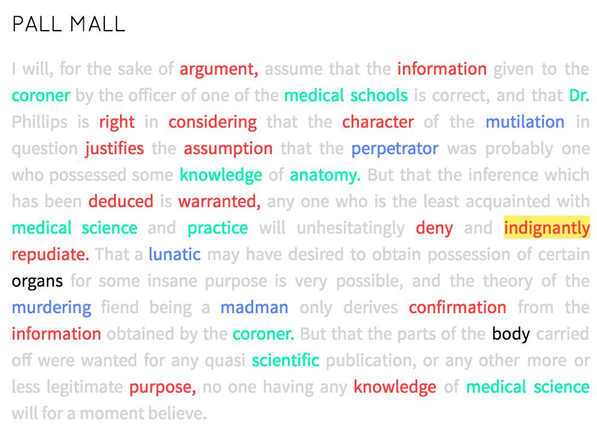
Topic Modeling
red: evidence
green: medicine
blue: murder
Notes:
A simulation of how you might have read the first text
This is text 1 in order. I ran it through a program – prism.scholarslab.org – to show the different themes. You might do it differently.
But when you’re reading, you probably do something similar.
Individual words suggest certain themes to you. And you internalize these when you read.
It’s also about clusters of these theme/topic rich words together.
We could go a step further and say that any text is made up a number of these themes, each of which is comprised of a series of words. When we read, we sift through the text and discern the themes at work. A flipped version would say that authors actually compose in the same way – they have buckets full of words that correspond to each theme. When composing this text, the author might have said something like:
I have some words related to evidence, some for medicine, and some for murder. I’m going to select some from each and arrange this text. But i’ll leave that bucket of words related to basketball alone.
A weird way to think about reading and writing / and it’s partially metaphor. But you can actually use a computer to work through metaphors like this for you.

Slide 16
Topic Modeling
Runs over a corpus
Pulls out statistically significant clusters of words in each document
More sophisticated than simple word counts
Gets at underlying themes/topics in docs – clusters of words that tend to co-occur are basically topics.
Notes:
So when you do topic modeling.
Assumes that there are significant topics or discourses at work in a text.
Tries to get at them by finding which words occur frequently together over time. At the end of the day, that results in a sense of the topic distribution.

Slide 17
Topic Modeling
red: evidence
green: medicine
blue: murder
Notes:
Would look at many many texts like these and say “what words tend to co-occur?”
This is text 1 in order. I ran it through a program – prism.scholarslab.org – to show the different themes. You might do it differently.
But when you’re reading, you probably do something similar.
Individual words suggest certain themes to you. And you internalize these when you read.
It’s also about clusters of these theme/topic rich words together.
We could go a step further and say that any text is made up a number of these themes, each of which is comprised of a series of words. When we read, we sift through the text and discern the themes at work. A flipped version would say that authors actually compose in the same way – they have buckets full of words that correspond to each theme. When composing this text, the author might have said something like:
I have some words related to evidence, some for medicine, and some for murder. I’m going to select some from each and arrange this text. But i’ll leave that bucket of words related to basketball alone.
A weird way to think about reading and writing / and it’s partially metaphor. But you can actually use a computer to work through metaphors like this for you.

Slide 18
In Practice, Looks Like This
Topic 1 (Evidence) – argument, right, considering, information, justifies, purpose, knowledge
Topic 2 (Medicine) – knowledge, medical schools, knowledge, medical science, coroner, Dr.
Topic 3 (Murder) – mutilation, perpetrator, lunatic, madman, murdering
Notes:
Produces a list of things like this. Note: a computer would not know anything about what these words MEAN. Only that they occur next to each other regularly. So we have to give them a label like ‘evidence topic’, etc.

Slide 19
Topic Modeling
Latent Direchlet Allocation (LDA) – the particular kind of topic modeling we are doing.
Don’t worry about what it means – just know the name. Sometimes you will see people refer to it as LDA.
It assumes that every potential topic contributes to a text in some way.
Notes:
The kind of topic modeling we are doing is called this.

Slide 20
Topic Modeling
Jack the
Ripper Text
20%
10%
15%
Evidence
Medicine
Murder
Notes:
So this sort of reading assumes a certain approach to composition. Pulling from different word buckets

Slide 21
Jack the
Ripper Text
20%
10%
15%
Evidence
Medicine
Murder
5%
30%
2%
Text about
Drone Deliveries

Slide 22
Topic Modeling
Latent Direchlet Allocation (LDA) – the particular kind of topic modeling we are doing.
Don’t worry about what it means – just know the name. Sometimes you will see people refer to it as LDA.
It assumes that every potential topic contributes to a text in some way.

Slide 23
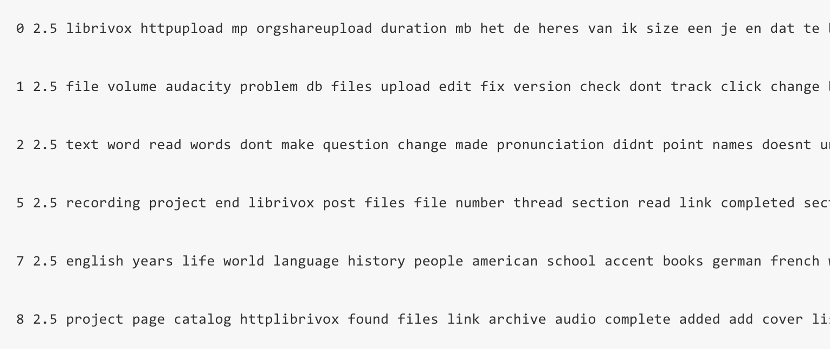

Slide 24
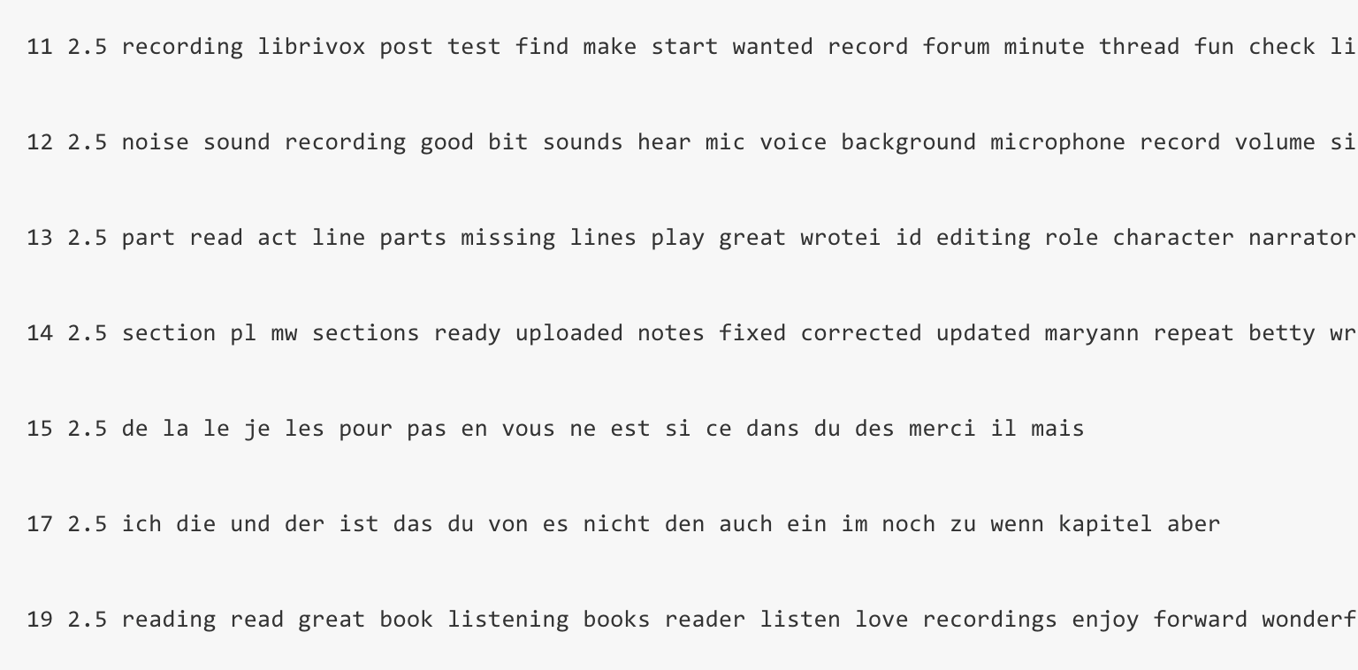

Slide 25
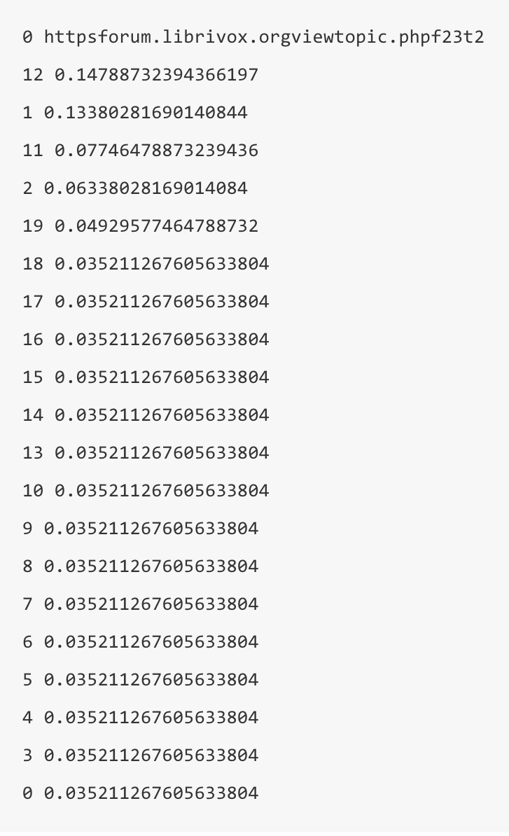
Notes:
Here it is with percentages on the left and then the percentage for each topic. So what topics were most prominent?

Slide 26
“When editing your reading, a quick fix of uneven levels (variations in volume) is to Normalise. This will soften the loudest passages and boost the quieter ones. It's not going to fix every variation in the recording, but it is a good first step to improving the recording overall.”
(The actual post that the computer was crunching)

Slide 27
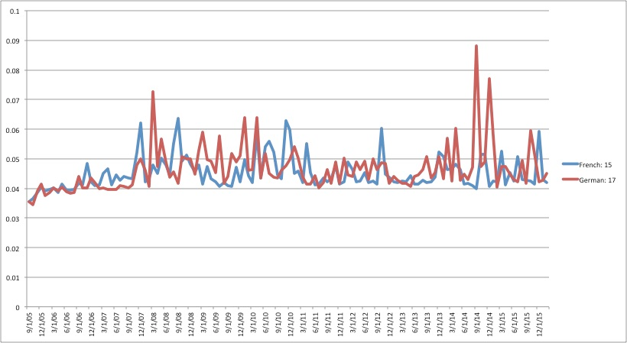

Slide 28
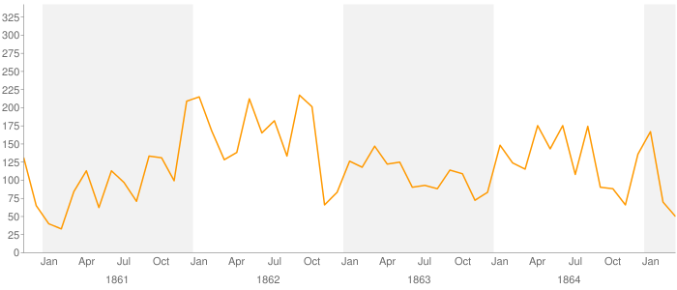
Topic Modeling
NEGRO YEARS REWARD BOY MAN NAMED JAIL DELIVERY GIVE LEFT BLACK PAID PAY RAN COLOR RICHMOND SUBSCRIBER HIGH APPREHENSION AGE RANAWAY FREE FEET DELIVERED
Fugitive Slave Ad topic from Mining the Dispatch
http://dsl.richmond.edu/dispatch/topics/view/15
Notes:
Here is an example of TM. If we have a whole lot of texts and we look at the topics over time, we can get a sense of how they change over time!
TM run over the Richmond Daily Dispatch during the civil war. This topic came to the surface. Knowing their corpus, they ID’d it as a fugitive slave topic. Charted over time, they can see that the number of fugitive slave ads spiked at particular times of union occupations – summer of 1862 and summer of 1864. “relative proximity of the union to enslaved people gave them a chance to escape or attempt to escape to freedom.
Their words - “What conclusions can we make from this kind of distant reading and draw from this graph specifically? For one, I think, this graph underscores the role of the Union army in presenting enslaved African Americans with opportunities—risky opportunities—to seize their freedom by running to the Yankee lines. There are two sustained spikes in the number of fugitive slave ads, the first in the summer of 1862 and the second in the summer of 1864. At both of those moments the Union army approached Richmond. In 1862 the Union army under McClennan approached within seven miles of Richmond during the Peninsula Campaign. (Jefferson Davis's coachman, William A. Jackson, was one of the slaves who ran to the Union army that spring.) Two summers later Grant's Overland Campaign brought Union armies near Richmond. The graph registers how during each of those summers enslaved men and women used to opportunity offered by relative proximity of the Union armies—which we might think of as a mobile North, bringing the free states closer to men and women enslaved in the South—to attempt to escape from bondage. A third spike at the end of 1861 is less explicable, and we'll return to it in a moment.”

Slide 29
Mining the Dispatch
Take some time to explore Mining the Dispatch
http://dsl.richmond.edu/dispatch/
What do you notice about the topics?
Are any legible to you as being about a coherent idea/theme/topic?
Can you find one that says something interesting over time?

